Slide 1

Property Energy Prediction
Team 7

Slide 2

AGENDA
01
Introduction
02
Business Solution
03
Approach
04
05
Model Development
Integration
06
Web Application
07
Q&A

Slide 3

Problem Statement
An energy consumption prediction is very significant to achieve efficient energy maintenance and reduce environmental effect
Due to improper usage, a tremendous amount of energy is wasted annually
ENERGY CONSUMPTION
With the advent of machine learning, accurately predicting future energy consumption becomes increasingly possible

Slide 4
Need for Data Driven Solution
Change habits without affecting our productivity or the quality of our lives
Better managing energy data unlocks new possibilities
Estimation of their energy bill
Practical
Technological
Check on emissions and relevant controls
Value Proposition
Economical
Competitive

Slide 5




Objectives
Accuracy
Support
Focusing on attaining high accuracy to provide reliable predictions to the customers
Develop Solution which enable customer with adequate support even after deployment
Sustainable Solution
User Experience
Enabling Customer with sustainable solution by collecting user data along with predictions
Providing Rich user Experience and customer centric approach

Slide 6



Use Case Approach
Identifying the Problem and Understanding Data
Featuring Engineering,
Model Development using Dataiku
UI for User/DB Admin
Dashboards and features for UX
Data Preparation
DB and UI
Ideation
Model Building
Web App
Extraction, Transformation and Loading of Data using Dataiku
Front end Integration using Django, DB setup and UI

Slide 7
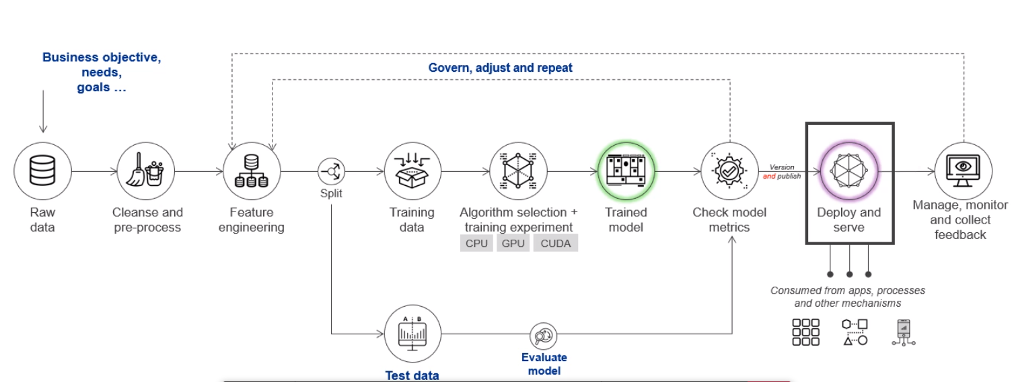
AIML Model Flow
Dataiku DSS
SQLite3 DB
Django
Web Application
Test Data

Slide 8
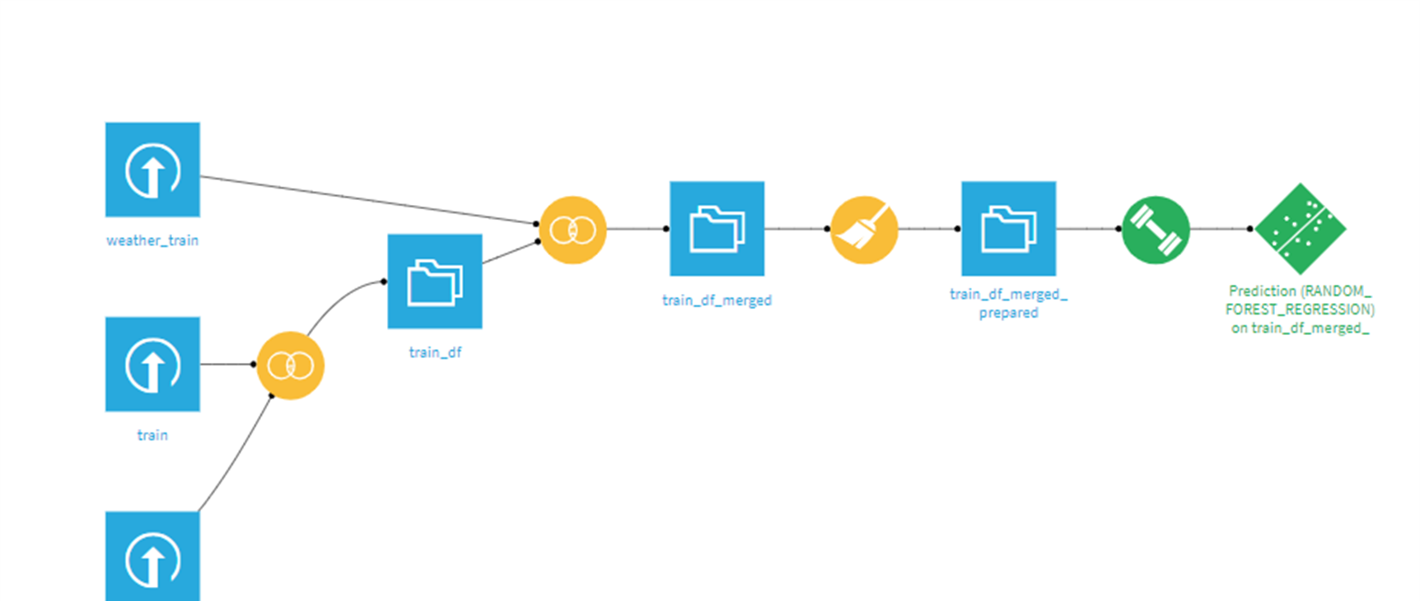
Dataiku Model Flow
76%
Gradient Boosted Trees Accuracy
XGBoost Accuracy
Random Forest Accuracy
Decision Tree
K nearest Neighbor

Slide 9
Random Forest
Feature Importance
Performance Metrics
93.2%
86.9%
Pearson coefficient
R2 Score or Accuracy
Correlation between actual and predicted value
Regression score function
0.869
283
RMSE Value
Explained Variance Score
Absolute measure of fit, RMSE is very low compared to very large data
Best Score is 1.0

Slide 10
SQLite3 DB- Admin Portal
Admin Access
User Profile
Admin Portal with access to DB with search enabled with any field of user input
Access to user profile table of DB
User Accounts are stored in a table
Resource Utilization
User Input
Dashboard access to DB Admin to very resource utilization
(refreshes every 3 seconds)
Accepts and Stores User Input.
It also Stores Output Prediction

Slide 11






Customer Web Application
User/ Admin Sign-in Authentication
Login Page for Users/clients and DB Admin. Includes Change Password and Email authentication
Single and Multiple Property Energy Predictor
User can provide input for one building to predict energy consumption. User can also upload a file to predict
User Profile Management
A quick view of client’s account
This page also allows user to update password
Chatbot
Chatbot is designed to handle user queries related to fields and web application navigation
Dashboard
Dashboard allows users to check history of predictions
Also, it provides quick insights of an user’s predictions so far

Slide 12



Django - Database
Website Authentication
File Upload
DB Admin Portal
In-built views for resetting and changing the password
Decorators for user/admin permissions
File Parsing Processing, writing output on the file and sending it back to UI
Access to retrieve Data from DB
SQLite3 DB
User Profile Data
User Portal
Object Relational Mapper(ORM) Model and DB Queries
ORM to save the i/p and user information in DB
Accepting input and predicting solution by invoking model pickle file

Slide 13
Key Outcomes
Efficient Model
Providing reliable results
Chatbots (Dialogflow)
Customer Support
Dashboard
Support by providing Quick insights on decision making
Database
Data Stored could be used for re-training
AIML Solution(Dataiku)
Accurate methods of Predictions in 2 formats
High User Experience (UI hosted Jupyter)
Enabled by rich UI

Slide 14
THANK YOU

Slide 15

Q&A

